Slide 1
Venn Diagram & Logarithms

Slide 2
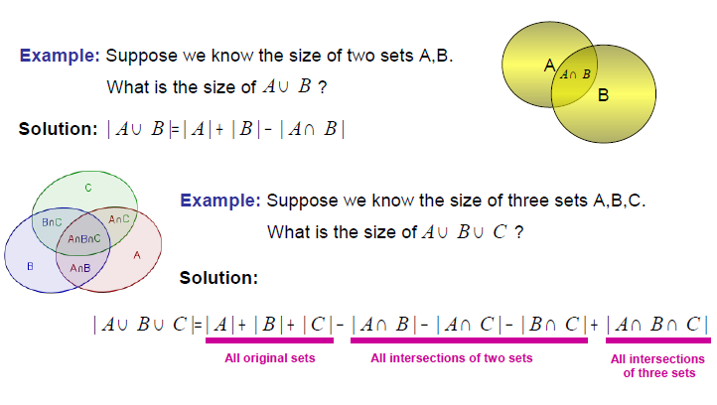
Venn Diagrams

Slide 3
Example:In a survey of 200 students of higher secondary school, it was found that 120 study mathematics, 90 study physics and 70 study Chemistry. 40 Study Mathematics and Physics, 30 Study Physics and Chemistry, 50 Study Chemistry and Mathematics and 20 Study none of the subjects. 1. How many studied all the 3 subjects? A. 10 B. 20 C. 30 D. 40 2. How many studied exactly one subject? A. 100 B. 110 C. 90 D. 120 3. How many studied at least two subjects? A.80 B. 90 C. 70 D. 40

Slide 4
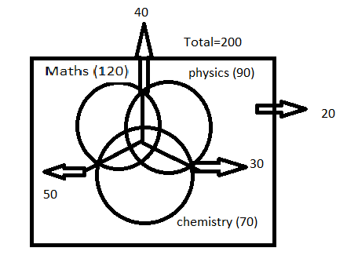
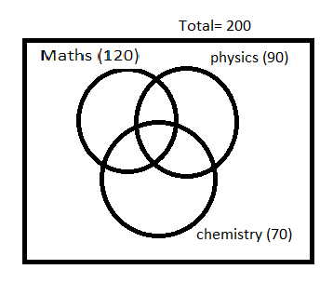
n(AuBuC) = N(A) + N(B) + N(C) – N(AnB) – N(AnC) – N(BnC) + N(AnBnC)
180 = 120+ 90 + 70 – 40 – 30 – 50 + x
180-160 = x
x = 20

Slide 5
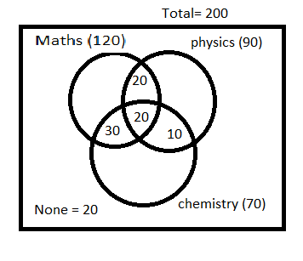
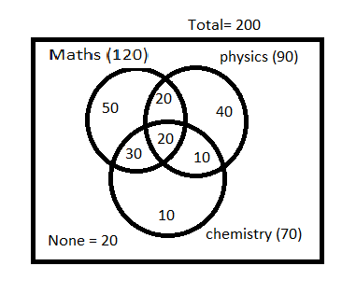
2. From the diagram , Exactly one subject = 50+40+10 = 100
3. From the diagram , Atleast two = 20+20+30+10 = 80

Slide 6
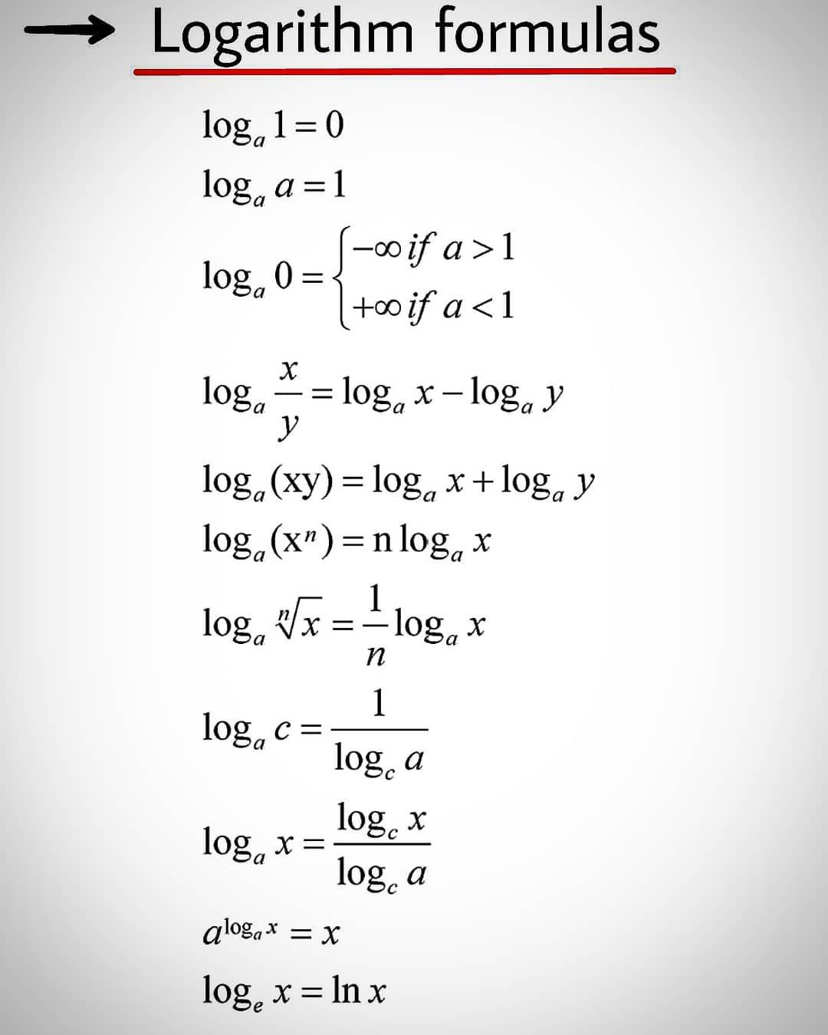
Logarithms

Slide 7
If logx 9 /16 = −1 /2 , then x is equal to: A. – 3/ 4 B. 3/ 4 C. 81/ 256 D. 256 /81
Solution:
X^(-1/2) = 9/16
X ^ (½) = 16/9
X = 256/81

Slide 8
The value of log₂(log₅625) is: A. 2 B. 5 C. 10 D. 15
Solution:
log₂(log₅625) = log₂(log₅5^4)
= log₂(4 log₅5)
= log₂(4)
= 2 log₂(2)
= 2

Slide 9
2log₁₀5+ log₁₀8 – 1/2 log₁₀4 = ?
Solution:
2log₁₀5+ log₁₀8 – 1/2 log₁₀4 = log₁₀5^2+ log₁₀8 – log₁₀4 ^1/2
= log₁₀ (25*8/2)
= log₁₀ 100
= 2

Slide 10
. If log₁₀5 + log₁₀(5x + 1) = log₁₀(x + 5) + 1, then the value of x is:
Solution:
log₁₀5 + log₁₀(5x + 1) = log₁₀(x + 5) + 1
log₁₀5 + log₁₀(5x + 1) = log₁₀(x + 5) + log₁₀(10)
Log₁₀(5 (5x + 1)) = log₁₀ (10(x+5))
25x + 5 = 10x + 50
15x = 45
X = 3

Slide 11
If log2 = 0.30103, the number of digits in 2^64 is:
Solution:
To find the number of digits in higher power using log
first apply log and find the corresponding logarithmic value Let that be n.
N will be in the form = x.######
To find the number of digits just add 1 to x.
So based on that
64 log 2 = 64 * 0.30103
= 19.26592
So number of digits = 19+1 = 20

